Slide 1
G2J Inventory Management System Members: Gloria Nzoh-Ndem, Jamison Brennan, John Kubas

Slide 2
Agenda
Product Overview
Project Management Plan
Requirements Specifications
Architecture and Design
Demonstration
Test Management
Project Outcomes/Limitations

Slide 3
Product OVerview

Slide 4

Product Overview
Grocery stores need to process many concurrent customer purchases while ensuring their inventory stays stocked with products in high demand.
This Inventory Management Program will process the items that are scanned and auto-order to assist with inventory management.

Slide 5
Product Overview
Products scanned corresponding to barcode
Barcodes transferred to Text File
Text File will be processed by program and adjust current inventory
New Inventory will be ordered when desired threshold met
Program connects to a database to consistently track inventory
Generate Inventory/Order Reports

Slide 6
Project Management plan

Slide 7
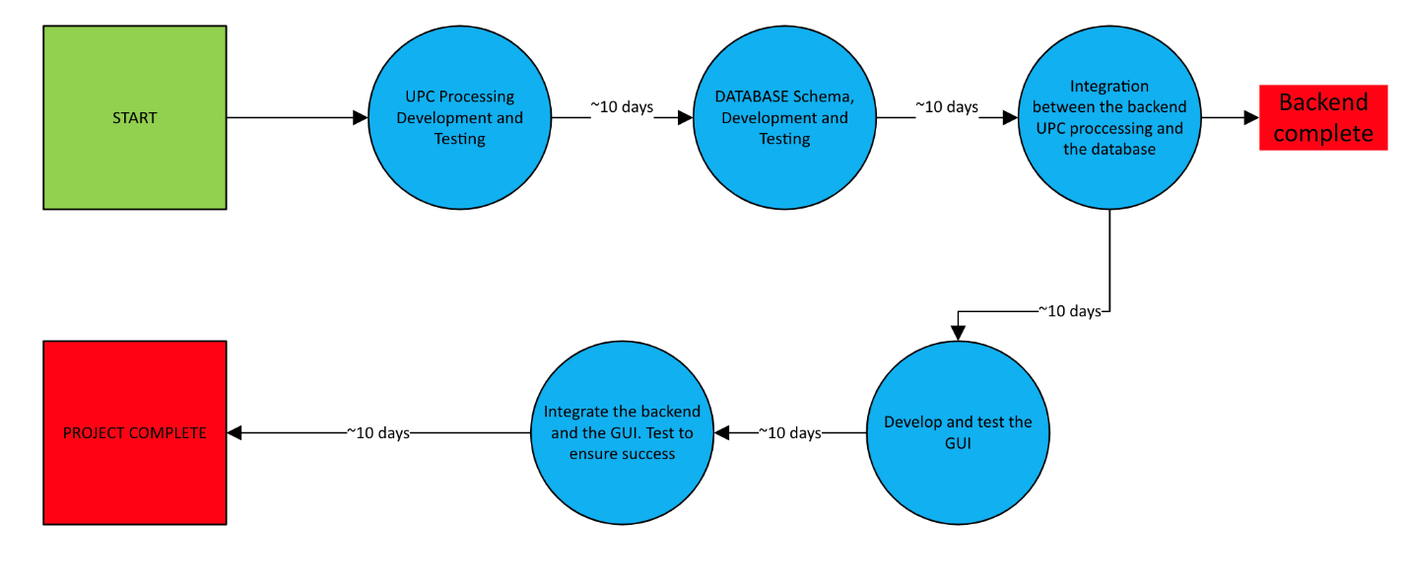
Project Management Plan
Figure 2-1 Task Network

Slide 8
Project Management Plan
Task Set:
Requirement Analysis (Weeks 1-6)
UPC processing logic (Develop and Test) (Week 7-8)
Design Database schema and create the database (Week 8-9)
Integrate the UPC processing logic software with the database to form the complete backend (Week 9-10)
GUI (Development and Testing) (Week 10-11)
Integration of Backend and GUI (Develop and Test) (Week 11-12)

Slide 9
Project Management Plan
Risk | Probability | Impact | RM3 Pointer
Software Tool underperformance | Moderate | Catastrophic | Implement rigorous testing (this includes unit, integration, and end-to-end), real-time monitoring of transactions, and continuous user feedback to refine the functionality.
Storage underestimate | Low | Serious | Optimize the memory allocation, conduct performance stress tests, and ensure efficient data handling to avoid storage limitations.
Storage underperformance | Moderate | Catastrophic | Implement automated backup systems, redundancy mechanisms, and database integrity checks to prevent data loss.
Size underestimate | Low | Moderate | Design a scalable system architecture, run the performance benchmarks, and allocate the resources dynamically based on usage demands.
Risk Management
Notes:
Software tool underperformance: Product inventory is not tracked accurately it will lead to incorrect ordering of new stock or not ordering enough stock to meet customer needs.
Storage underestimate: Memory is not properly allocated to meet the needs of the number of products and inventory needed by the customer.
Storage underperformance: Persistent storage of inputs to the system fails and inventory is not correctly tracked between sessions.
Size underestimate: The size of the system has been underestimated, slowing down processing of information and program execution.

Slide 10
Requirements Specification

Slide 11
Stakeholders
Inventory Control Specialist(ICS):
Mid-level employee who will be updating the program when new inventory is received and responsible for overall inventory management. May have little programming experience.
Cashier:
Entry-level employee who will be scanning barcodes to update product purchases. May have no programming or computer experience.
Store Manager:
Higher level employee who will have program oversight and will be reviewing inventory updates, product orders and run reports

Slide 12

Use Case: Inventory Control Specialist (ICS)
Inventory Management System: Inventory Processing Use Case
Actors | ICS, Store Manager, System Input File, Inventory Management System
Description | ICS may update the input file with desired product barcodes, units per case and threshold of when new product orders need to be initiated. ICS will transfer input file data to Inventory Management System and update as new Inventory is received. ICS can run reports listing current inventory and expected replacement inventory.
Data | Current Inventory count, Units per Case, new Inventory Count
Stimulus | User command issued by ICS
Response | Confirmation that the Inventory has been updated.
Comments | The ICS must have appropriate security permissions to create the input file and update the Inventory Management System. The store manager should also have the same security permissions as backup to ICS and for proper oversight.

Slide 13
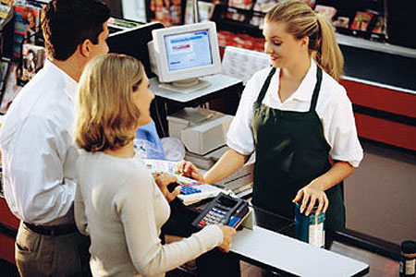
Use Case: Cashier
Inventory Management System: Process Barcodes Use Case
Actors | Cashier, Cash Register, Inventory Management System
Description | Customers will arrive at the checkout with their products for purchase. Cashiers will scan or enter barcodes in the cash register system. The barcodes will be added to a text file which will be used to update the count in the Inventory Management System.
Data | Product barcodes
Stimulus | Cashier scans or enters barcode
Response | Confirmation that barcode is valid and transfer data to text file.
Comments | Cashiers will have access permissions for the system used to scan or enter barcode (cash register).
This Photo by Unknown Author is licensed under CC BY-SA-NC

Slide 14

Use Case: Store Manager
Inventory Management System: Report Generation Use Case
Actors | Store Manager, Inventory Management System
Description | The store manager can generate reports on current inventory, product inventory trends and expected inventory for delivery.
Data | Current Inventory count, Units per Case, new Inventory Count, Report
Stimulus | User command issued by Store manager.
Response | Output file created with contents of report.
Comments | The Manager must have appropriate security permissions to generate reports.
This Photo by Unknown Author is licensed under CC BY

Slide 15
Nonfunctional Requirements
Security:
Ensure secure connections to the MySQL database using SSL or other security protocols. Only authorized users can initiate inventory updates or view reports.
Performance:
Process the barcode file and update inventory within 1 second for up to 100 entries. Reports shall be generated under 5 seconds, even for large inventories.
Reliability:
Handle errors gracefully, such as missing barcode files or database connection failures.
Maintainability:
Support easy updates and bug fixes
Scalability:
Handle increasing inventory sizes without significant performance degradation.
Availability:
Run continuously, or on a schedule and support automatic recovery or manual restart w/o data loss.

Slide 16
Architecture and Design

Slide 17
Architecture
Software architecture structured as a modular, three-tier/layer system
Consists of:
Presentation layer for user interaction
Application layer for business logic
Data layer for persistent storage
All interconnected to support the system’s core functions:
barcode-driven transaction processing
inventory updates
order generation.

Slide 18
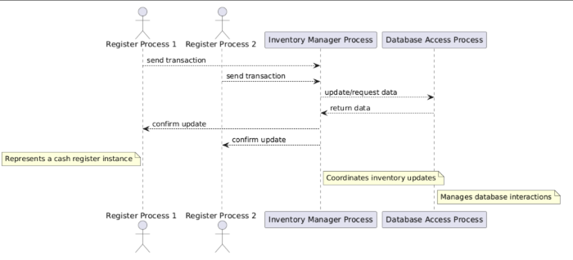
Architecture Process View

Slide 19
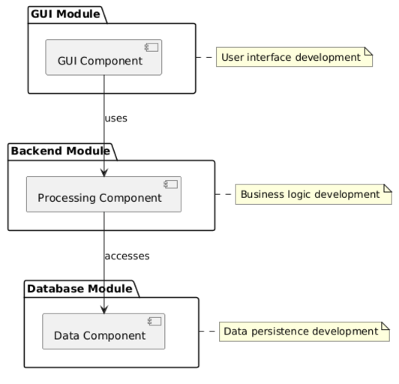
Architecture Development View

Slide 20
Architecture Rationale
Scalability
The application layer can scale independently (e.g., multiple processes parsing barcodes), and presentation layer can support future interfaces without changing underlying logic or database.
Reliability
The layers can be isolated, ensuring if a presentation layer crashes, it does not affect the core processing and the back-end logic still functions.
Centralizing the logic in the application layer allows for consistent handling of errors (e.g., invalid barcodes, stock miscounts).
Maintainability
The presentation layer can be updated without touching the database or core logic.
Business rules can also be modified in the application layer without rewriting how data is stored.

Slide 21
Design: Entity Relationship
Product to Inventory: (1:1) One-to-One
Each product will have a single corresponding inventory entry that will track its stock levels.
Product to Transaction: (1:M) One-to-Many
A single product can have or be involved in multiple transactions as it is sold over time.
Product to Order: (1:M) One-to-Many
Single product can have multiple orders placed when the stock falls below the reorder threshold.
Inventory to Transaction: (1:M) One-to-Many
Each inventory entry is updated by multiple transactions as the products are sold.
Inventory to Order: (1:M) One-to-Many
Each inventory entry can trigger multiple orders when the stock levels require a refill.

Slide 22
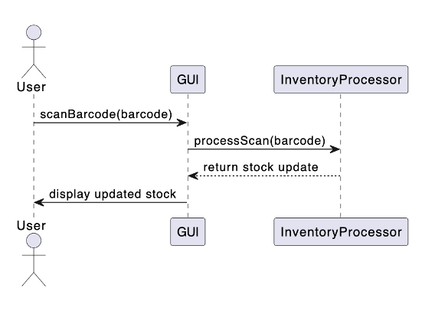
GUI Dynamic Model

Slide 23

Demonstration

Slide 24

Test Management
This Photo by Unknown Author is licensed under CC BY-SA-NC

Slide 25
Test Environment
Development Workstation:
MacBook Pro (e.g., 16GB RAM, 2.6 GHz multi-core CPU, macOS)
Code creation, initial testing, and development of the Python-based application and MySQL database interactions.
Primary development and unit testing environment
Database Server:
A single server with 16GB RAM and a 4-core CPU to host the MySQL database
Ensuring robust data persistence and concurrent access.

Slide 26
Test Environment
Unit Testing: unittest (Python’s built-in testing framework)
Test individual components, such as UPC processing logic and inventory updates
Integration Testing: pytest
Used with plugins for testing interactions between the GUI, Inventory Processor, and Data Manager
Performance Testing: Apache Jmeter
Used to simulate concurrent transactions from multiple cash registers, testing the system’s ability to process barcode files within 1 second for up to 5-10 entries.
Database Testing: MySQL Workbench and Custom SQL scripts
Used to validate data integrity, persistence, and transactional updates.

Slide 27
Test Environment
GUI Testing: PyQtTest or Selenium (if a web-based GUI is implemented)
Used to automate user interface interactions, such as product entry and report generation
Simulators
Used to custom Python scripts, and they are developed and executed on the MacBook Pro, to emulate barcode scanner inputs, generating text files with UPC codes to mimic cash register outputs.
Test Files:
These are in the format of CSV files containing sample product data and transaction logs, created and managed on the MacBook Pro.

Slide 28
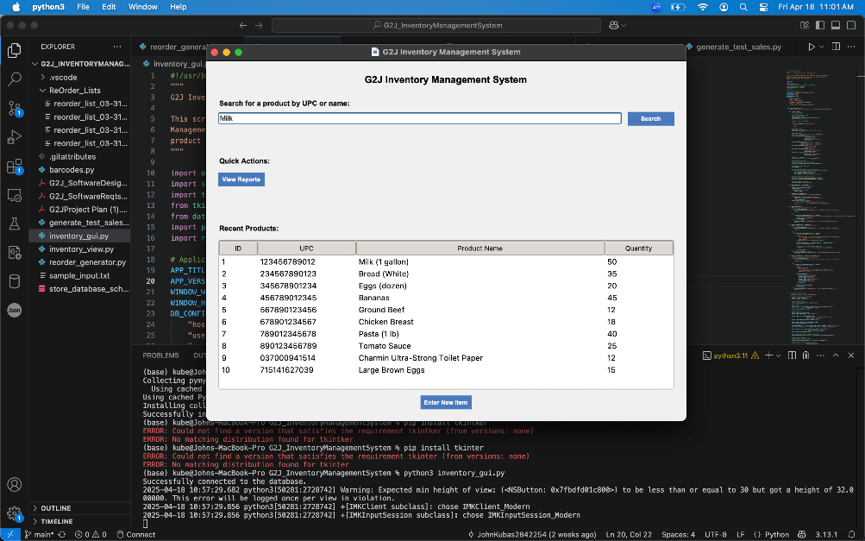
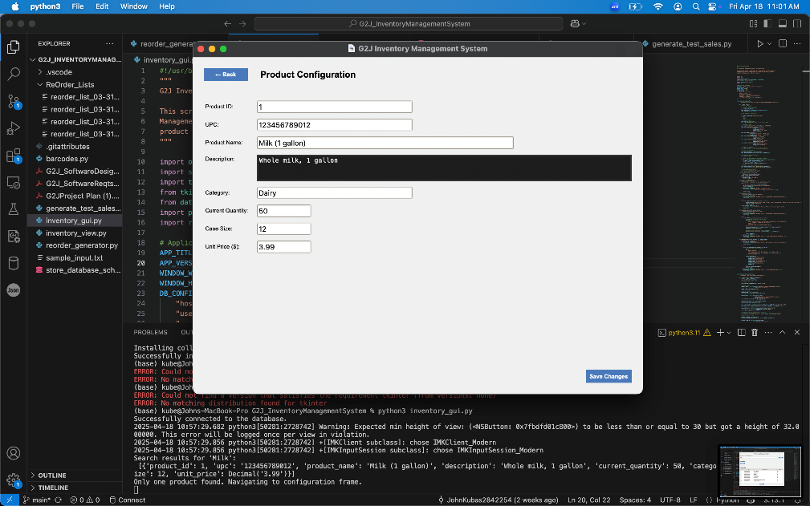
Test Use Case 1: Successful Query of Existing Item by Name
ID | 1
Test Input | Scan barcode "123456789012" (CurrentStockUnits = 50)
Expected Output | CurrentStockUnits = 49, transaction recorded, UI updates quantity
Description | Tests Cashier barcode scan and inventory update.

Slide 29
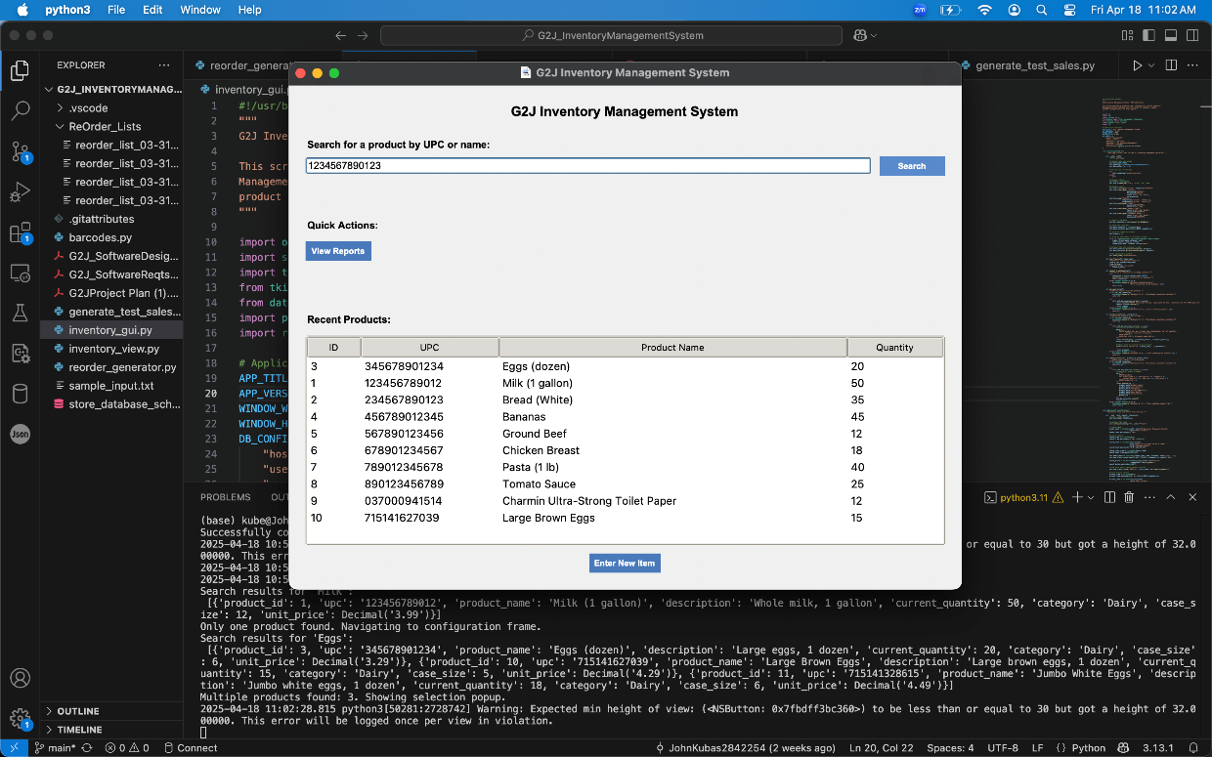
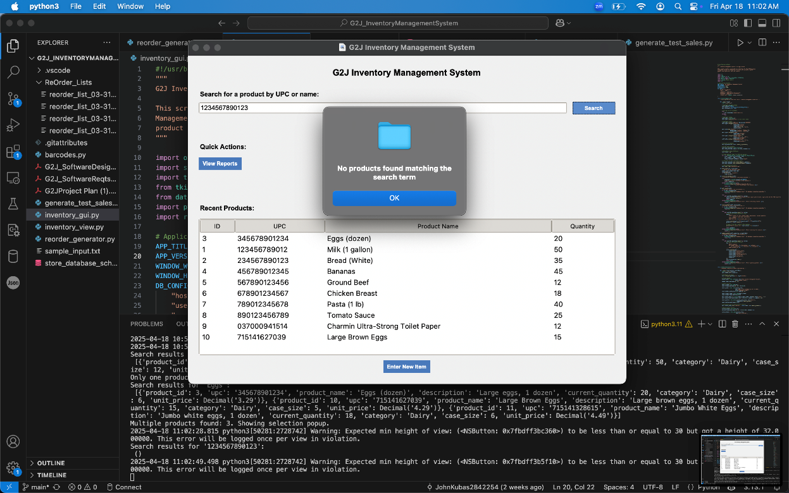
Test Use Case 2: Searching invalid item by UPC
ID | 2
Test Input | Enter UPC= "1234567890123" in the search bar on the dashboard, click "Search"
Expected Output | "No products found matching the term" message appears, "Recent Products" list remains unchanged
Description | Tests searching for a non-existent product by UPC and verifies error handling

Slide 30
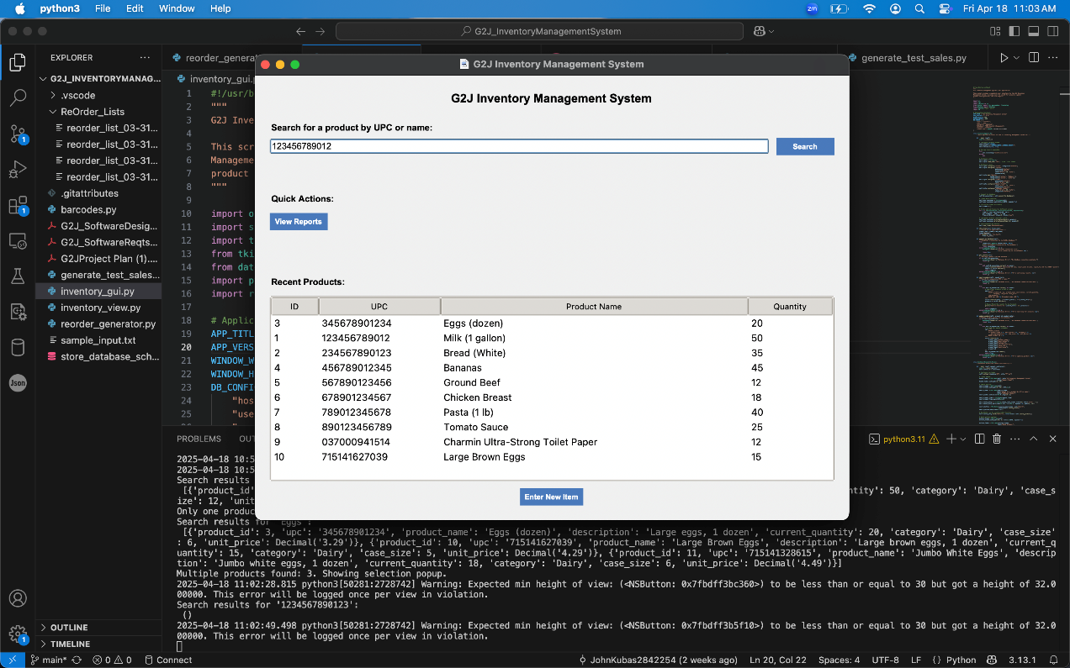
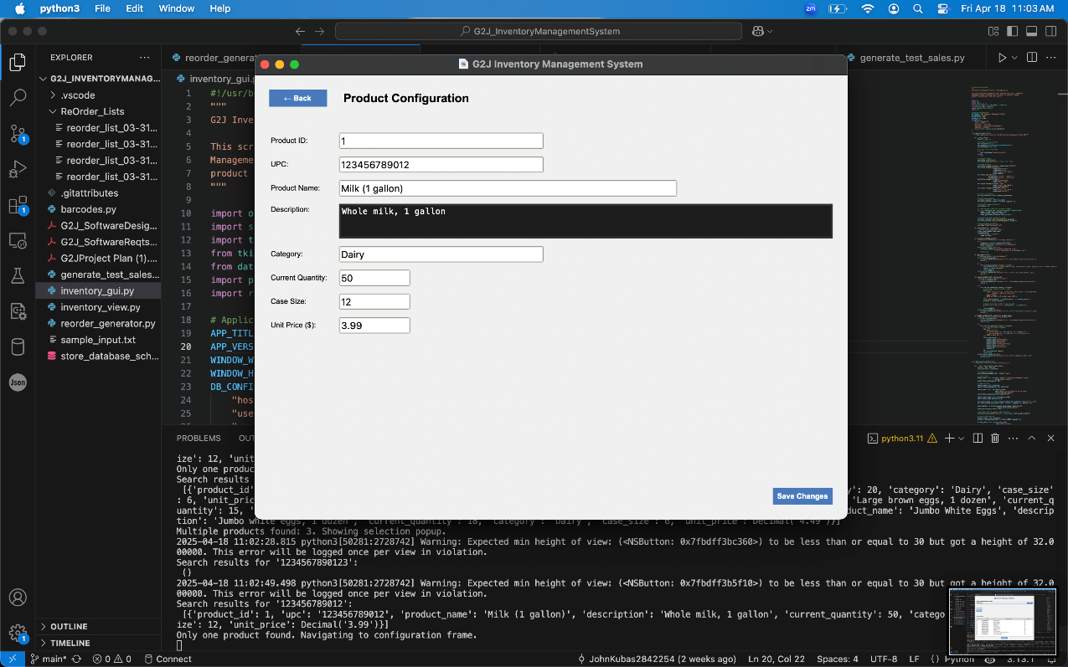
Test Use Case 3: Searching for Valid Item by UPC
ID | 3
Test Input | From dashboard, select "Milk (1 gallon)" (UPC ="123456789012") from "Recent Products" list
Expected Output | Product configuration screen loads with ProductID = 1, UPC= "123456789012", Product Name="Milk (1 gallon)", Description "Whole milk, 1 gallon", Category "Dairy", Current Quantity is 50, Case Size 12, Unit Price $3.99
Description | Tests navigation to product configuration screen and verifies product details

Slide 31
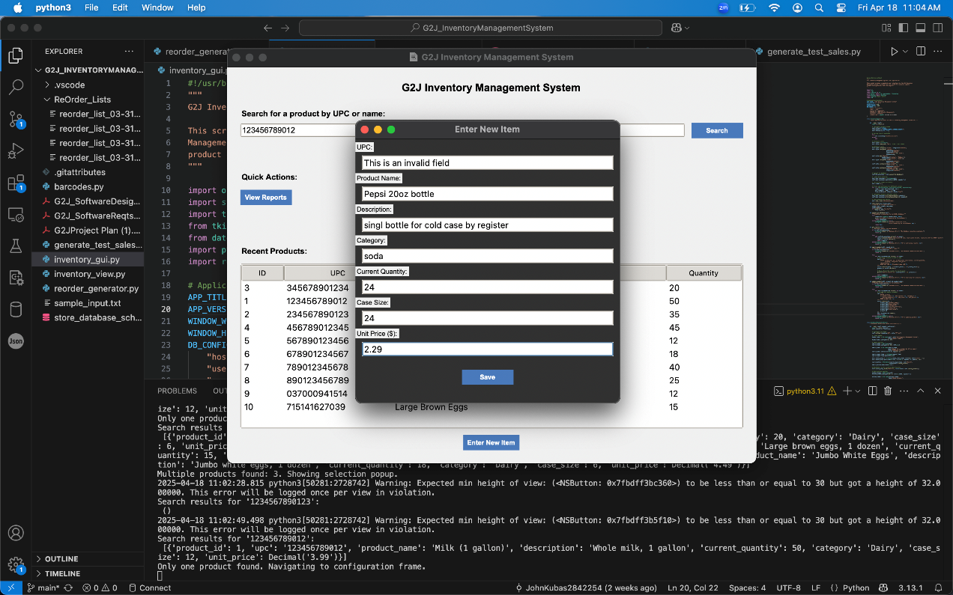
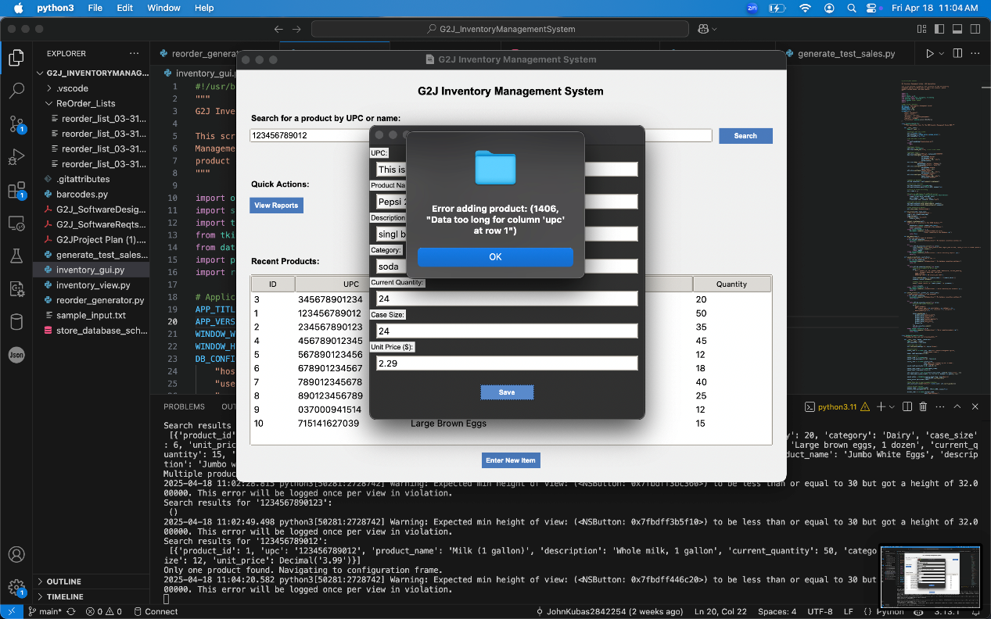
Test Use Case 4: Adding Item with Invalid Fields
ID | 4
Test Input | Click "Enter New Item", input UPC "" (empty), Product Name ="Pepsi 20oz bottle", Description "single bottle for cold case by register", Category "Soda", Current Quantity is 24, Case Size 24, Unit Price $2.29, click "Save"
Expected Output | UPC field highlights with "This is an invalid field", clicking "Save" shows error: "Data row too long for column 'UPC' at row 1", product not added, "Recent Products" list unchanged
Description | Tests error handling for invalid UPC when adding a new product

Slide 32
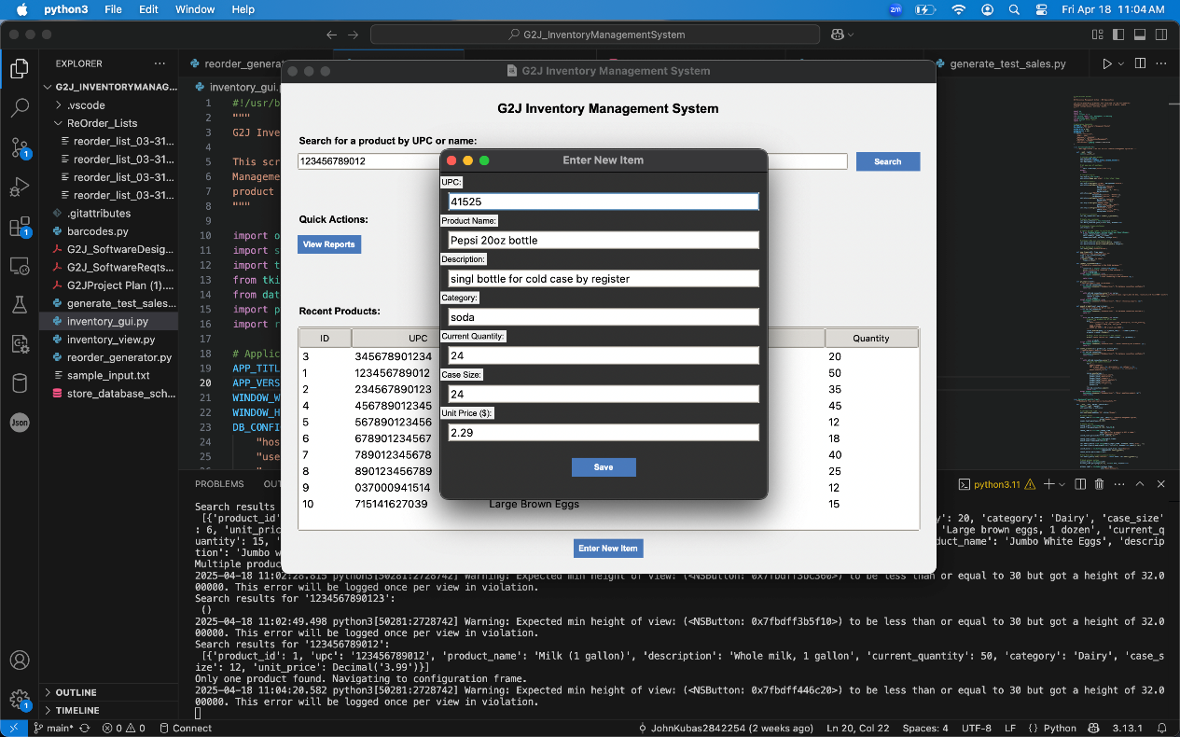
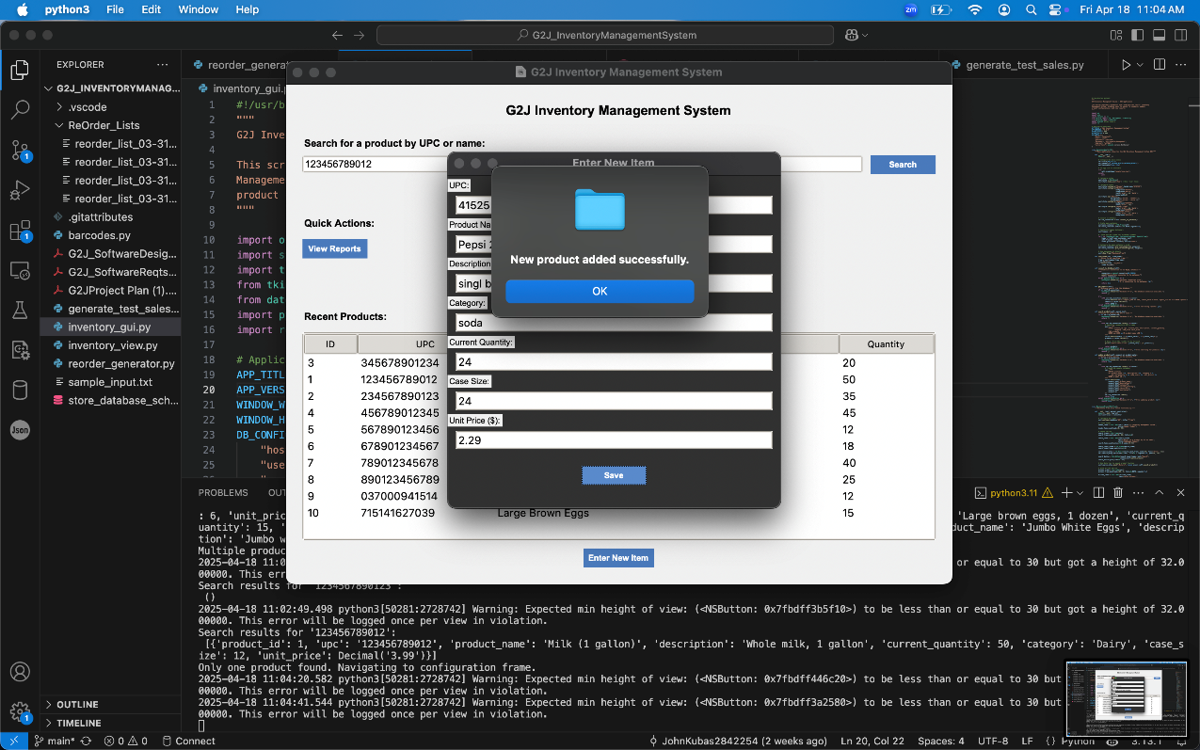
Test Use Case 5: Adding Item with Valid Fields
ID | 5
Test Input | Click "Enter New Item", input UPC "41525", Product Name "Pepsi 20oz bottle", Description "single bottle for cold case by register", Category "Soda", Current Quantity 24, Case Size 24, Unit Price $2.29, click "Save"
Expected Output | "New product added successfully" message appears, dashboard "Recent Products" list updates with UPC "41525", Product Name "Pepsi 20oz bottle", Quantity 24
Description | Tests adding a new product via the "Enter New Item" screen

Slide 33
Project outcomes/Limitations

Slide 34
Project outcomes/limitations
The design and implementation of the software, including the user interface, are subject to the following restrictions, limitations, and constraints derived from the project plan:
Limited Product Scope: The initial UI will only support a small sample of products and barcodes due to time and resource constraints. This limits the configuration screen’s capacity to handle the full 100,000+ products required by the customer, requiring future scalability enhancements.
Budget Constraint: Lack of funding to purchase bulk products and barcode lists restrict the UI to manually entered or sampled data, potentially impacting the realism of testing and configuration workflows.

Slide 35
Project outcomes/limitations
Risk of Storage Underperformance: If the persistent database fails, the UI’s inventory updates and reports may display inaccurate data, requiring robust error-handling mechanisms (e.g., offline mode or alerts) in the design.
Scalability Challenge: The initial system size may be underestimated, potentially slowing UI responsiveness as product volume grows. The design incorporates a scalable architecture, but resource allocation must be dynamically adjusted.

Slide 36
Questions?

